Slide 1

LiDaR Predictive Linear Models for Livestock Production
Arturo Macias Franco
BIOL792
Dr. Thomas Parchman
12, 2021

Slide 2
Intro
My research
Project Idea
Project Reality
Improvement
Suggested framework for regression analysis

Slide 3
Mathematical Nutrition and Modeling Laboratory
Animal Nutrition and production
Sustainability
Microbiology
Modeling
Addressing issues through mathematical models

Slide 4


Project Idea
Automating data extraction from LiDaR images
Previous work predicting carcass and physical composition from morphometric measures

Slide 5
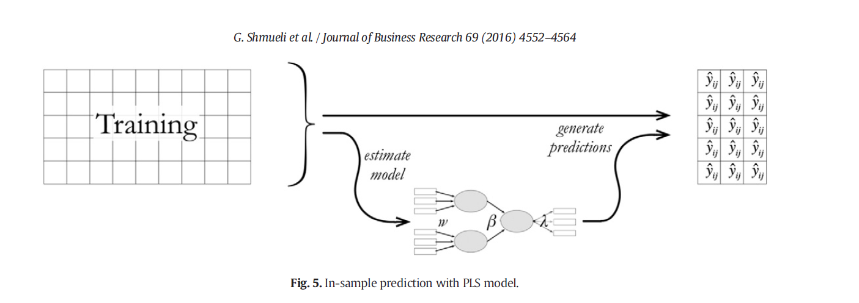
Mathematical Models
Schmueli et al., 2016
https://doi.org/10.1016/j.jbusres.2016.03.049
Elephant in the room: fitted vs predicted
Notes:
So we know the potential benefits of mathematical models.
How can predictive models be misleading?
~ fitted vs predictive statistics and clearly distinguishing between them

Slide 6

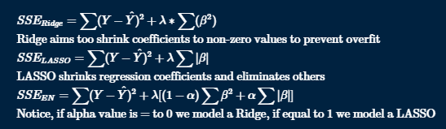

Regression models~continued
Smith, 2018
doi:10.1186/s40537-018-0143-6.
Parameter selection
A statistical sin?
Notes:
Quite prevalent in animal science literature, we see predictive models with a overutilization of stepwise parameter selection.
~ stepwise relies on statistical significance in a series of “steps” to determine the “significant” variables that are to be kept in a model, order may affect (depending on algorithm), interactions may result in biologically relevant variables being omitted due to a lack of statistical significance.
~ FWD, BCKWD, Bid Stepwise

Slide 7

Ridge
Hoerl and Kennard, 1970
DOI: 10.1080/00401706.1970.10488634
Multicolinearity
$l^{2}−norm$ (Euclidean Distance)
Notes:
Ridge is the total response variable, minus the total predicted value plus the l2 penalty term given as lambda and the sum of beta squares. While mimizing sum of squares the l2 penalty term makes coefficients shrink.
“Euclidean distance”
Useful in attempting to battle multicollinearity by applying penalization coefficients to the regression coefficients

Slide 8

LASSO
Tibshirani, 1996
Parsimony (garrote/ridge)
The lasso represents the $l^{1}−norm$penalization (Manhattan distance)
Notes:
Subset selection provides interpretable models but can be extremely variable because it is a discrete process- regressors are either retained or dropped from the model. Small changes in the data can result in very different models being selected and this can reduce its prediction accuracy. Ridge regression is a continuous process that shrinks coefficients and hence is more stable: however, it does not set any coefficients to 0 and hence does not give an easily interpretable model.
How is the lasso, a better alternative than the garrote?
The lasso avoids the explicit use of the OLS estimates, and therefore does not suffer of highly correlated predictors such as in the garrote
Garrote estimations retain the OLS estimate signs, the LASSO does not, and often changes the signs of the coefficients.
Limited in that if p >> n, the maxible number of predictors selected in the model is n. Usually gene data can have issues when examining gene microarrays.
We propose a new technique, called the lasso, for 'least absolute shrinkage and selection operator'. It shrinks some coefficients and sets others to 0, and hence tries to retain the good features of both subset selection and ridge regression.
Hui Zou 2006 proposed the Adaptive lasso where adaptive weights are used for penalizing different coefficients in the l1 penalty.
The LASSO possesses L1 no
For lasso, the total actual minus the predicted response squared, plus lambda times the absolute value of the coefficients, applies an L1 penalty term which shrinks some features to zero. Some of the LASSO coefficients shrink down to zero. Useful in feature selection.
rm penalization leading to shrinkage (continuous) as well as variable selection such as in Stepwise.
How do you get the standard errors in the LASSO?
The LASSO standard errors are estimated via bootstrapping comparing them to the real values.

Slide 9

Elastic Net
Zou and Hastie, 2003
“the best of two worlds”
$l^{1}−norm$ for sparse models
$l^{2}−norm$ for grouping and stabilization of $l^{1}$
$p≫n$ (microarray datasets)
Notes:
“ A convex combination of the lasso and the ridge penalty”
(1-$1−α) |β|_1+α|β |^2$
Utilizes l1 and quadratic parts of penalization through which you can generate a sparse model (l1), and the quadratic part of the penalty removes the limitation on the number of selected variables, encourages grouping effect, and it stabilizes the l1 regularization path.
The error sum of squares for elastic net is a combination of ridge and lasso, in this equation, if alpha is zero, you get ridge, if it is one, then you get the lasso. It generates the best combination between lasso and ridge.
Useful for large feature dataset size, p >> n, where p are the predictors, and n are observations.

Slide 10
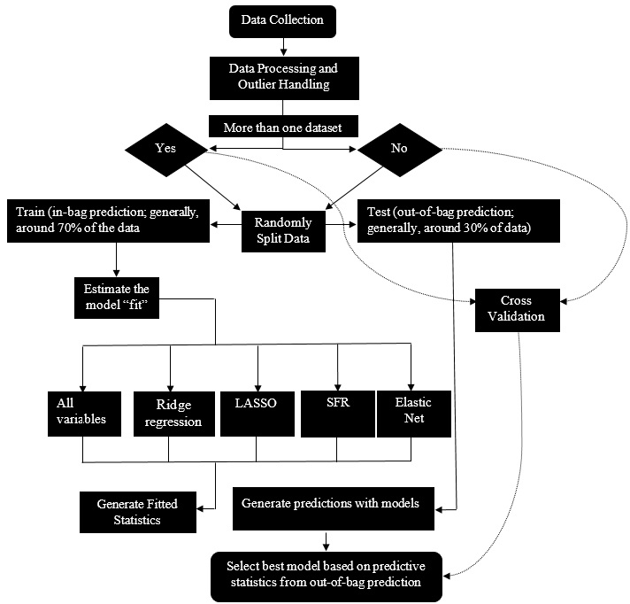

Slide 11
Show me something
Table 1. Evaluation and assessment of currently published predictive equations for carcass and empty body physical fat measures compared to newly generated predictive equations with the MANU framework
No. ª | Method^{b} | Equations^{c} |  | R^{d} | RMSE^{e} | MAE^{f} | CCC^{g} | Cb^{h}
Carcass physical fat
Reparametrized | BID | = -31.522 (4.387) + 0.173 (0.010) * SBW |  | 0.825 | 11.223 | 8.979 | 0.838 | 0.923
MANU | LASSO | = -95.719 + 0.076* (SBW) + 1.265 * (HBW) + 0.147 * (PBW) + 0.024 * (PGL) + 0.592* (RiDe)-0.503* (Sc) + 0.273 * (DIAG) |  | 0.838 | 7.366 | 6.151 | 0.902 | 0.985
Empty body physical fat
Reparametrized | BID | = -190.333 (17.219) + 2.661 (0.770) * HBW + 1.982 (0.478) * RiDe |  | 0.861 | 28.043 | 24.287 | 0.672 | 0.724
MANU | NET | = -140.975 + 0.217 * (SBW) + 1.953 * (HBW) + 0.220 * (RuHe) + 0.267 * (PGL) - 0.714 * (Sc) + 0.300 * (DIAG) + 0.106 * (AbWi) |  | 0.859 | 11.020 | 9.953 | 0.924 | 0.997
ª Reparametrized = represents currently published models reparametrized with our data for prediction; MANU = best three equations generated with the proposed MANU framework ^{b} Feature selection method: BID = bidirectional stepwise selection, LASSO = least absolute shrinkage and selector operator, NET = net elastic regression ^{c} parentheses with numbers in equations represent standard error ^{d} R² = goodness of fit ^{e} RMSE = root mean squared error ^{f} MAE = mean absolute error ^{g} CCC = concordance correlation coefficient ^{h} Cb = correction bias

Slide 12

Code/Sample ~
wxpython ~
pyrealsense2
opencv

Slide 13
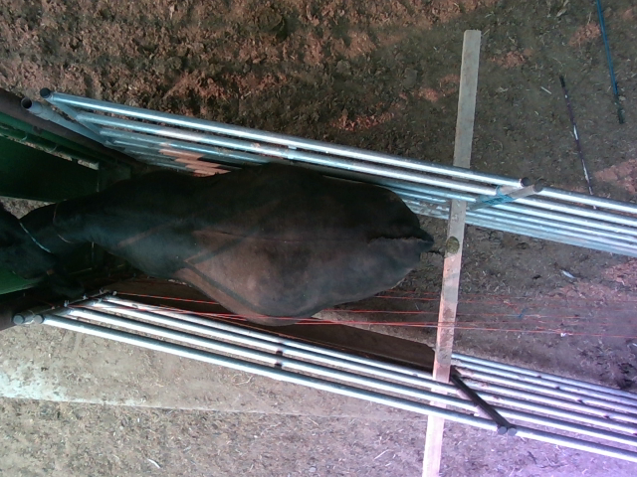
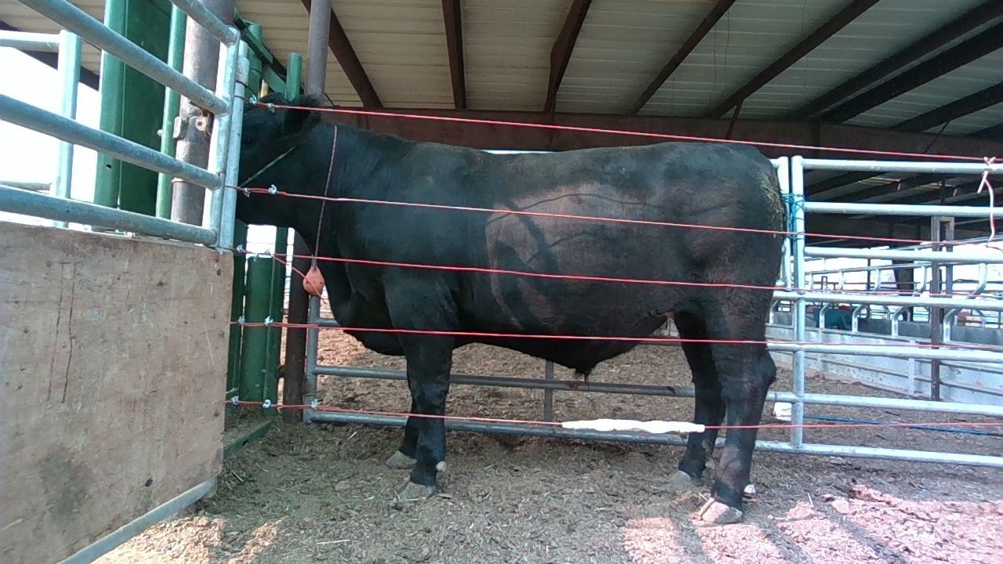
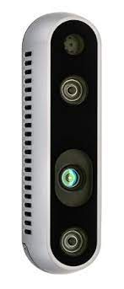
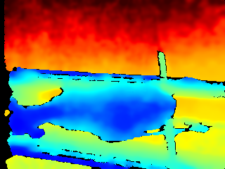
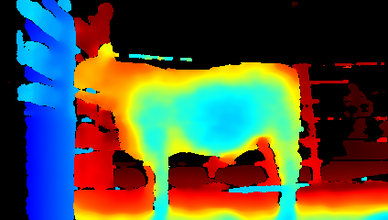

Slide 14
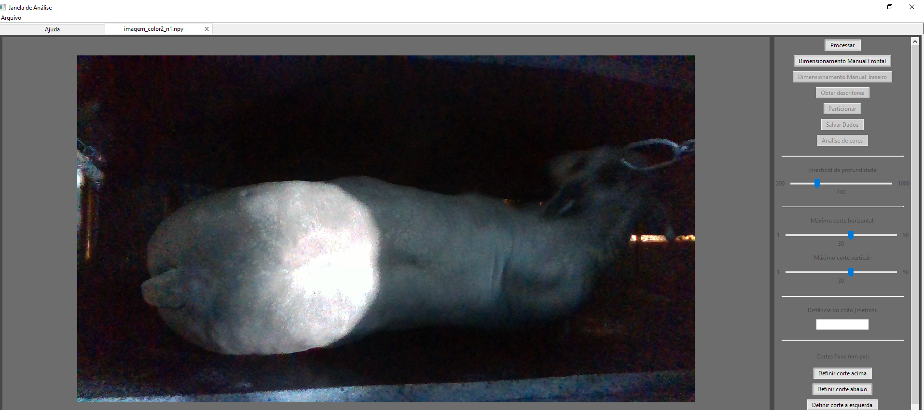

Slide 15
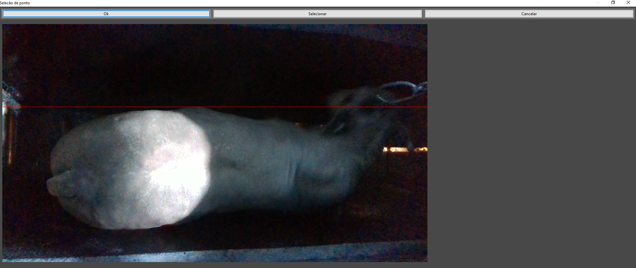

Slide 16
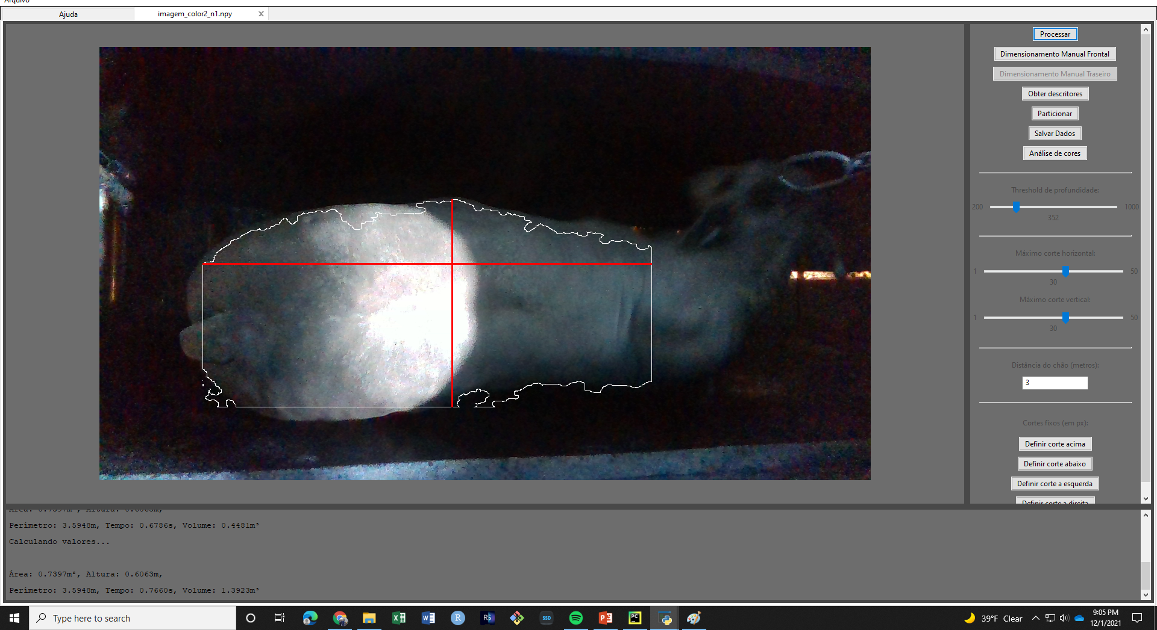

Slide 17
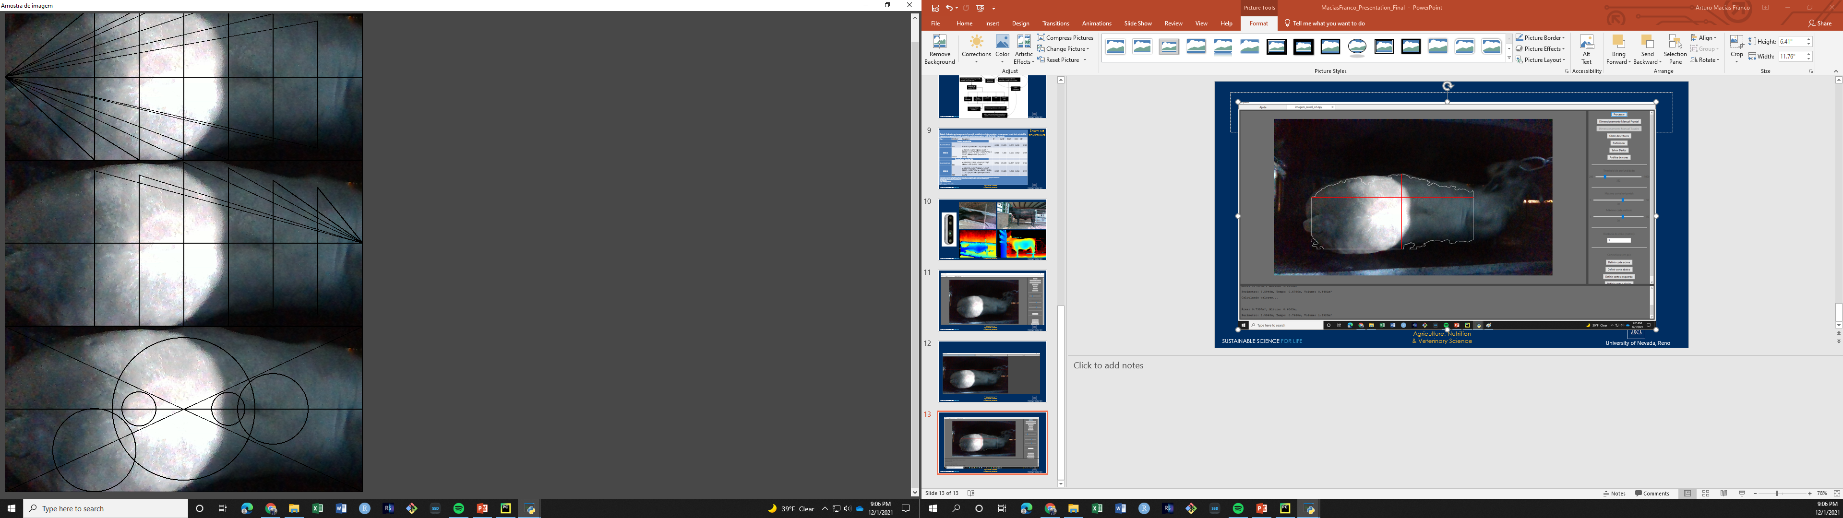
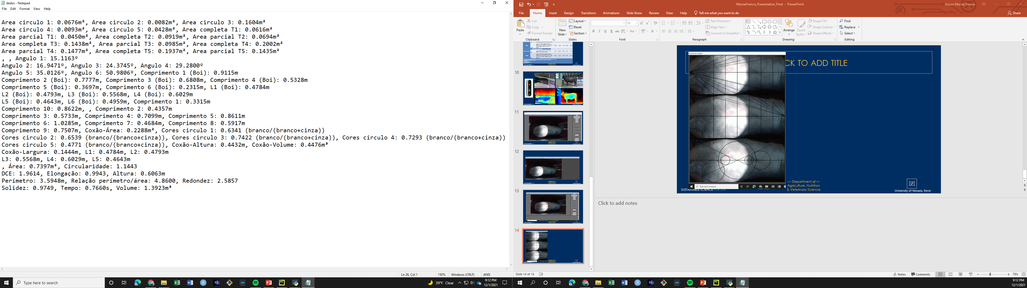

Slide 18
Future Work
Collaborate
:D

